Slide 1

Welcome
Design Principles
Notes:
Mandatory
ACTION: Adjust title to fit your course.

Slide 2
Design Principles
Best practices or suggested practices to increase code quality.
There are easy and hard ones.
Programming language and frameworks can help you.
No rule without exception.
Experience comes with time.

Slide 3
Coherent
Not Coherent
Not Coherent
Parser
URLPunctuationParser
parseURL(URL url)
parseDate(Date date)
parse(URL url)
parseText(String text)
URLParser
Represents a whole concept. Includes the complete URL parsing features like host, protocol, resource, etc.
parse(URL url)
DateParser
parse(Date date)

Slide 4
SOLID
The SOLID principles were introduced by Robert C. Martin in his 2000 paper “Design Principles and Design Patterns.” These concepts were later built upon by Michael Feathers, who introduced us to the SOLID acronym. And in the last 20 years, these five principles have revolutionized the world of object-oriented programming, changing the way that we write software.
Notes:
https://fi.ort.edu.uy/innovaportal/file/2032/1/design_principles.pdf

Slide 5
Single Responsibility Principle
Based on the principle of cohesion, as described by Tom DeMarco in his book Structured Analysis and System Specification (1979), and Meilir Page-Jones in The Practical Guide to Structured Systems Design (1988).
“A class should have one and only one reason to change”
Notes:
The more responsibilities your class has, the more often you need to change it.

Slide 6
Open-Closed Principle
Bertrand Meyer coined the open-closed principle in 1988. It means simply we should write our modules so that they can be extended, without requiring them to be modified. In other words, we want to be able to change what the modules do, without changing the source code of the modules.
“Open for extension and closed for modification”
Notes:
Example: Real life analogy: Smartphones
We have core functionality in the OS, such as telephoning, SMS and data transfer,
Apps can enhance and provide more functionality without changing the core functionality

Slide 7
OCP violation in example code
public class Alarm
{
// …
private Sensor sensor = new Sensor();
Want to use new type of sensor?
Must modify code; cannot extend it

Slide 8
Liskov Substitution Principle
Introduced by Barbara Liskov in a 1987 conference keynote address titled Data abstraction and hierarchy
Subclasses should substitute the parent class
Any child type of a parent type should be able to stand in for that parent without things blowing up
“Derived classes should be substitutable for their base classes”

Slide 9
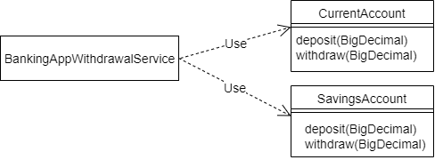
Banking application
Our banking application supports two account types – “current” and “savings”. These are represented by the classes CurrentAccount and SavingsAccount respectively.
Notes:
Unfortunately, there is a problem with extending this design. The BankingAppWithdrawalService is aware of the two concrete implementations of account. Therefore, the BankingAppWithdrawalService would need to be changed every time a new account type is introduced.

Slide 10
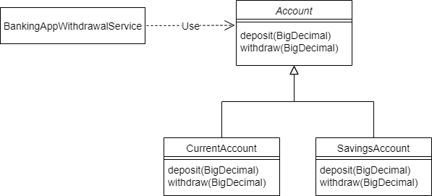
Liskov Substitution Principle
Using the Open/Closed Principle to Make the Code Extensible

Slide 11
A new account type
public class FixedDepositAccount extends Account {
@Override
protected void deposit(BigDecimal amount) {
// Deposit into this account
}
@Override
protected void withdraw(BigDecimal amount) {
throw new UnsupportedOperationException("Withdrawals are not supported by FixedDepositAccount!!");
}
}
public class FixedDepositAccount extends Account {
// Overridden methods…
}
Notes:
This will make the Banking application to crash, in case someone tries to use the withdraw method. This shows there is clearly something wrong with this design if a valid combination of objects results in an error.

Slide 12
What went wrong ?
The WithdrawalService is a client of the Account class. It expects that both Account and its subtypes guarantee the behavior that the Account class has specified for its withdraw method
However, by not supporting the withdraw method, the FixedDepositAccount violates this method specification. Therefore, we cannot reliably substitute FixedDepositAccount for Account.
In other words, the FixedDepositAccount has violated the Liskov Substitution Principle

Slide 13
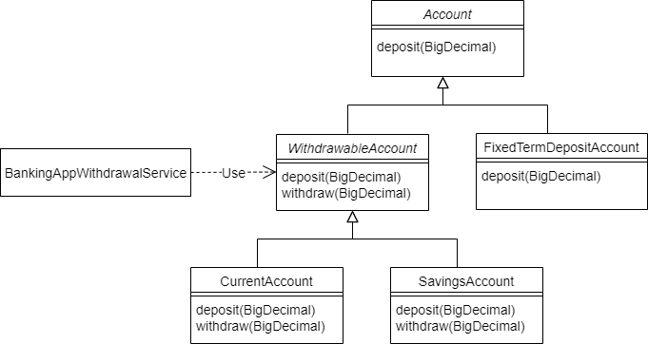
Revised class diagram
Notes:
Because all accounts do not support withdrawals, we moved the withdraw method from the Account class to a new abstract subclass WithdrawableAccount. Both CurrentAccount and SavingsAccount allow withdrawals. So they've now been made subclasses of the new WithdrawableAccount.

Slide 14
Refactored BankingAppWithdrawalService
public class BankingAppWithdrawalService {
private WithdrawableAccount withdrawableAccount;
public BankingAppWithdrawalService(WithdrawableAccount withdrawableAccount) {
this.withdrawableAccount = withdrawableAccount;
}
public void withdraw(BigDecimal amount) {
withdrawableAccount.withdraw(amount);
}
}
Notes:
This means BankingAppWithdrawalService can trust the right type of account to provide the withdraw function.

Slide 15
Interface Segregation Principle
Robert C Martin while consulting for Xerox
Make fine grained interfaces that are client specific
The goal of this principle is to reduce the side effects of using larger interfaces by breaking application interfaces into smaller ones. It's similar to the Single Responsibility Principle, where each class or interface serves a single purpose.
“Clients should not be forced to depend upon interfaces that they do not use”

Slide 16
Example
public interface Payment {
void initiatePayments();
Object status();
List<Object> getPayments();
}
Notes:
Let's look into a situation where we've got a Payment interface used by an implementation BankPayment:

Slide 17
Example
public class BankPayment implements Payment {
@Override
public void initiatePayments() {
// ...
}
@Override
public Object status() {
// ...
}
@Override
public List<Object> getPayments() {
// ...
}
}
Notes:
And the implementation:

Slide 18
Polluting the interface
Now, as we move ahead in time, and more features come in, there's a need to add a LoanPayment service. This service is also a kind of Payment but has a few more operations.
public interface Payment {
// original methods
...
void intiateLoanSettlement();
void initiateRePayment();
}

Slide 19
LoanPayment implementation
public class LoanPayment implements Payment {
@Override
public void initiatePayments() {
throw new UnsupportedOperationException("This is not a bank payment");
}
@Override
public Object status() { // ... }
@Override
public List<Object> getPayments() {// ... }
@Override
public void intiateLoanSettlement() { // ...}
@Override
public void initiateRePayment() {// ...}
}
Implementing unwanted functions could lead to many side effects. Here, the LoanPayment implementation class has to implement the initiatePayments() without any actual need for this.
Notes:
Now, since the Payment interface has changed and more methods were added, all the implementing classes now have to implement the new methods.

Slide 20
public class BankPayment implements Payment {
@Override
public void initiatePayments() { // ...}
@Override
public Object status() { // ... }
@Override
public List<Object> getPayments() { // ...}
@Override
public void intiateLoanSettlement() {
throw new UnsupportedOperationException("This is not a loan payment");
}
@Override
public void initiateRePayment() {
throw new UnsupportedOperationException("This is not a loan payment");
}
}
Implementing unwanted functions could lead to many side effects. Here, the BankPayment implementation class has to implement the initiateLoanSettlement() without any actual need for this.
Notes:
what happens to our BankPayment class:
BankPayment implementation now has implemented the new methods. And since it does not need them and has no logic for them, it's just throwing an UnsupportedOperationException. This is where we start violating the principle.

Slide 21
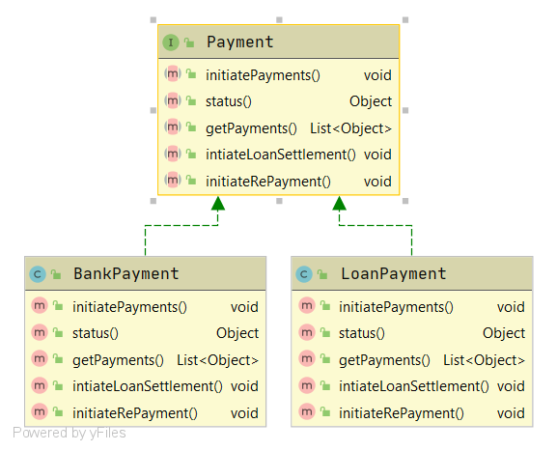
Applying the principle
Notes:
Notice in the class diagram, and referring to the interfaces in the earlier section, that the status() and getPayments() methods are required in both the implementations. On the other hand, initiatePayments() is only required in BankPayment, and the initiateLoanSettlement() and initiateRePayment() methods are only for the LoanPayment.
With that sorted, let's break up the interfaces and apply the Interface Segregation Principle. Thus, we now have a common interface:

Slide 22
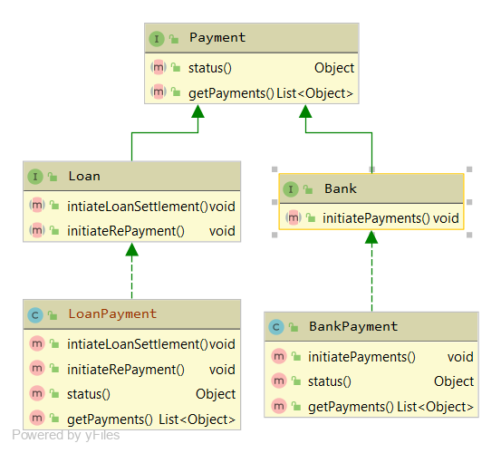
Applying the principle
Notes:
As we can see, the interfaces don't violate the principle. The implementations don't have to provide empty methods. This keeps the code clean and reduces the chance of bugs.

Slide 23
Dependency Inversion Principle
The dependency inversion principle was postulated by Robert C. Martin
High-level modules should not depend on low-level modules. Both should depend on abstractions.
Abstractions should not depend on details. Details should depend on abstractions.
“Depend on abstractions, not on concretions.”

Slide 24
DIP violation in example code
High Level Class
public class Alarm
{
// …
private Sensor sensor = new Sensor();
Dependency
Low Level Class

Slide 25




Thank you!

